Slide 1

RME322 EMBEDDED SYSTEMS
Fall 2023
Intelligent Automatic Dustbin
Using Ultrasonic Sensors and Servo-Based Control
Muhammad Mamoon
L1F23BSRI0014
Muhammad Asad Ali
L1F23BSRI0024

Slide 2
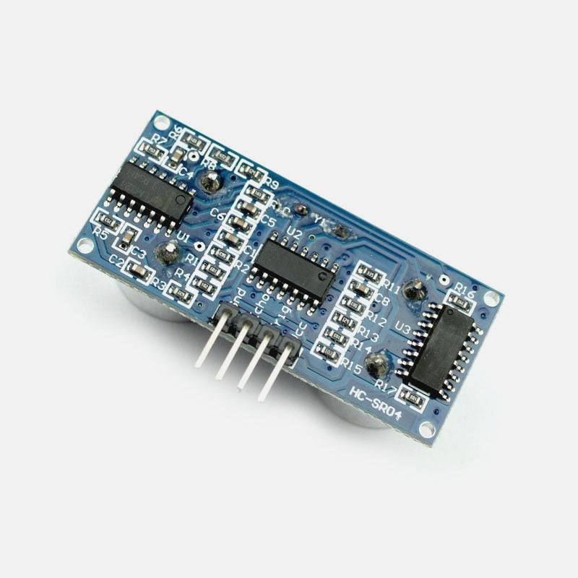
Project Overview
Core Objective
An intelligent dustbin system that enhances hygiene and waste management through sensor-based automation, demonstrating practical embedded systems application.
Key Innovation
Contactless operation with fill-level awareness prevents overflow and maintains hygiene through intelligent feedback control.
System Features
Real-time status indication
Safe and efficient operation
Practical sensor-actuator integration
Core Components
2x Ultrasonic
Servo Motor
ESP DEVKIT V1
LED Indicators

Slide 3
Motivation & Significance
Problems
Our Solution
Manual Operation Issues
Contactless Operation
Physical contact spreads germs and creates hygiene risks in public spaces
Eliminates physical contact through ultrasonic sensor-based detection
Existing Systems Limitations
Fill-Level Intelligence
Lack fill-level awareness, leading to overflow and system misuse
Prevents overfilling by monitoring capacity and disabling operation when full
Safety Concerns
Real-Time Feedback
No feedback mechanisms for safe operation and overflow prevention
LED indicators ensure safe, efficient operation with visual status updates
3
2
100%
LED Indicators
Ultrasonic Sensors
Contactless
Real-time status feedback
User & fill-level detection
Hygienic operation
Impact: Suitable for households, hospitals, offices, and public spaces requiring enhanced hygiene standards

Slide 4
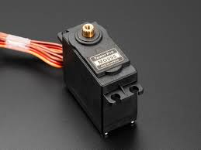
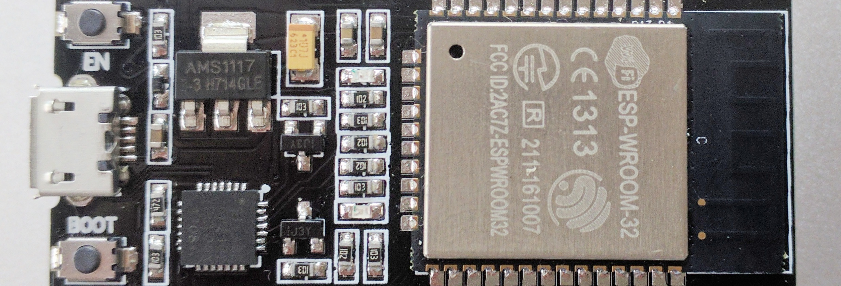
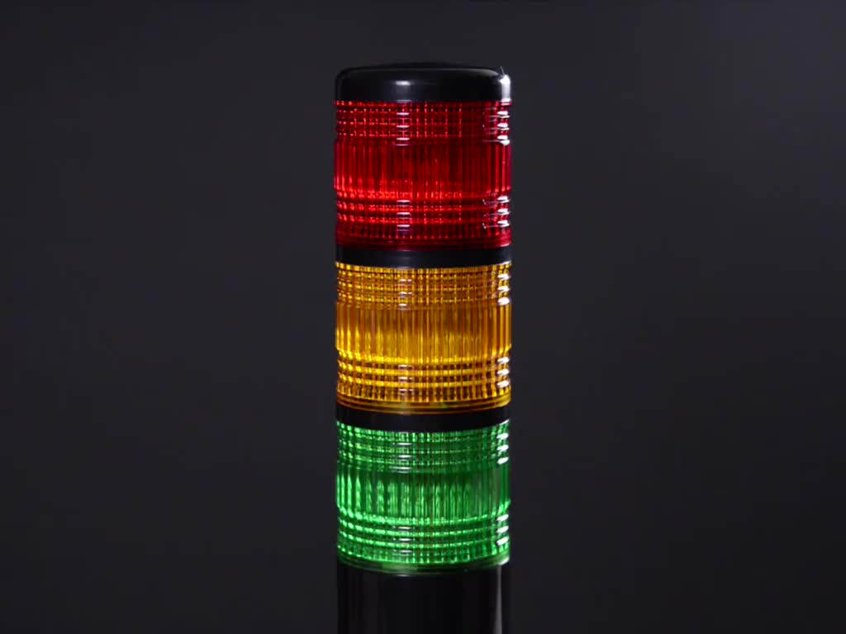
System Components
Microcontroller
Sensors
Servo Motor
Sensor 1
External Detection
Detects user/object near dustbin and triggers lid opening
Metal Gear MG90s
Controls lid operation based on sensor feedback
ESP DEVKIT V1
Sensor 2
LED Indicators
Central processing and control unit for the entire system
Internal Detection
Monitors fill level and prevents overfilling
Real-time sensor processing
Servo motor control
LED feedback management
Bin Full
Warning
Normal
Additional: Power supply and structural enclosure
All components integrated for intelligent operation

Slide 5
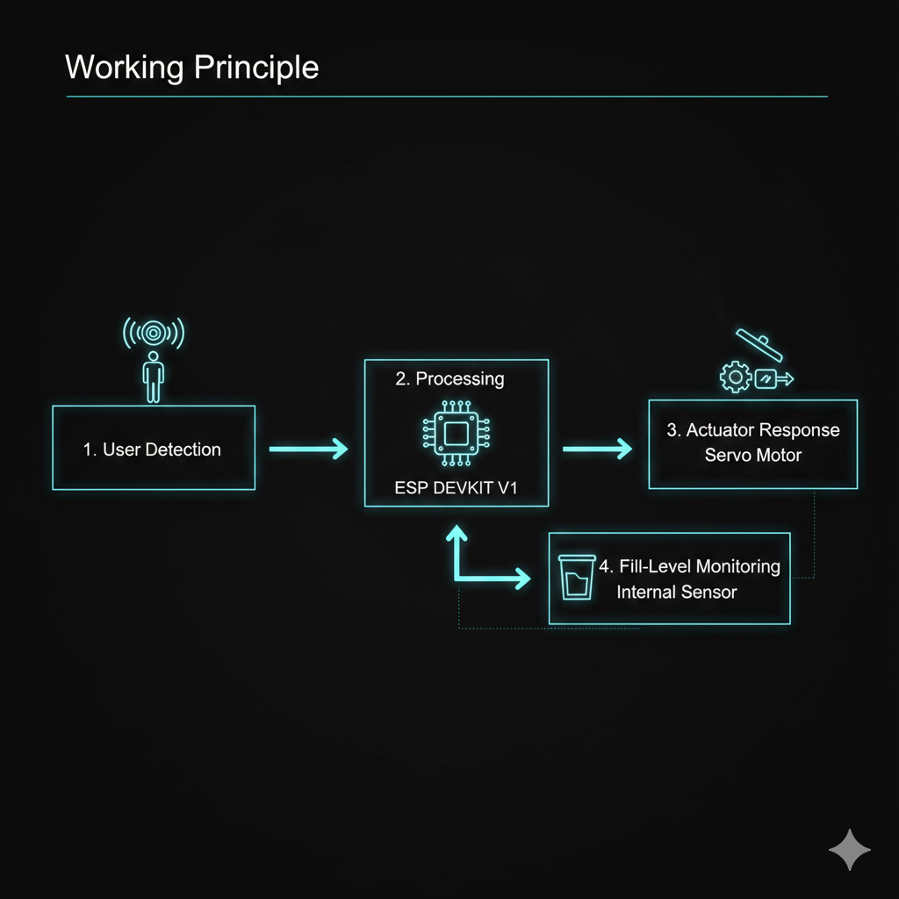
Working Principle
Full State
1
User Detection
When bin reaches maximum capacity:
External ultrasonic sensor detects user or object near the dustbin
Disables lid-opening mechanism
Triggers servo motor to automatically open the lid for waste disposal
Activates red indicator LED
Prevents further use until emptied
Safety Check
2
Lid Operation
Before closing the lid:
Lid remains open for a predefined delay period
System rechecks for object presence
Allows sufficient time for safe and convenient waste disposal
Yellow LED provides visual warning
Prevents accidental closure
Normal State
3
Fill-Level Monitoring
When capacity is available:
Internal ultrasonic sensor continuously monitors the fill level
Green LED indicates normal operation
Provides real-time feedback to prevent overfilling
Lid operates normally
System ready for use

Slide 6
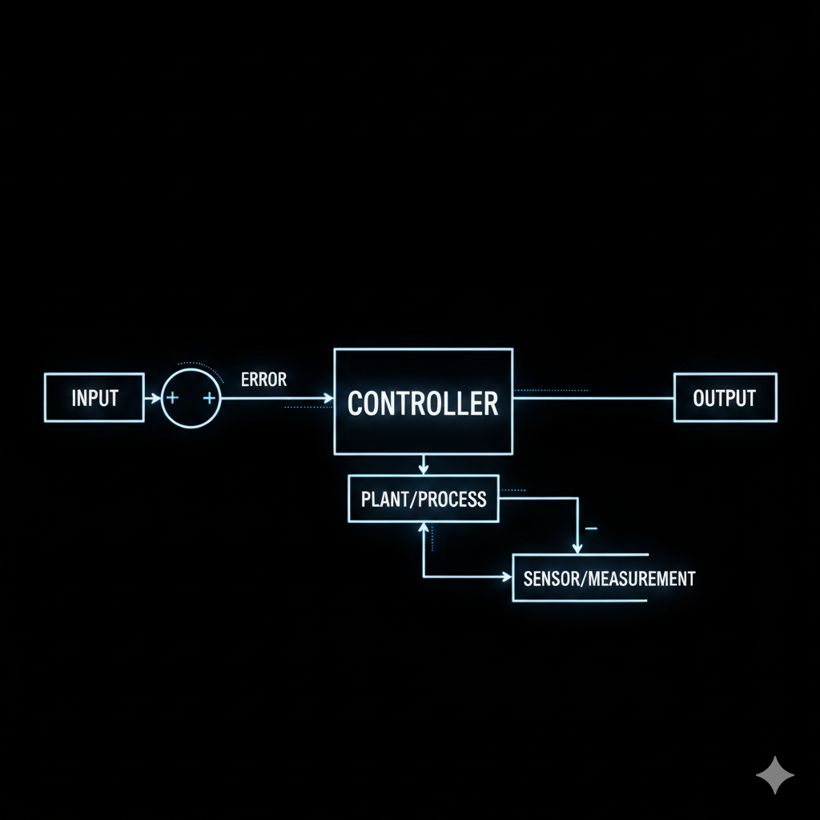
Feedback Control System
Integrated Feedback Mechanism
Continuous real-time monitoring with intelligent decision-making
Sensors provide constant input to the microcontroller, enabling dynamic system responses based on current conditions
Key Benefits
Control Loop
Enhanced Safety
1
Sensor Input: External & internal sensors detect conditions
Prevents overflow and ensures safe operation
Efficient Operation
2
Microcontroller Processing: ESP DEVKIT V1 analyzes data
Optimizes lid operation and reduces power consumption
3
Actuator Response: Servo motor & LEDs respond appropriately
Improved User Experience
4
Continuous Monitoring: Loop repeats for real-time updates
Clear visual feedback and reliable operation
Real-Time Feedback: System responds within milliseconds to any status changes
Active Monitoring

Slide 7
Future Enhancements
Wireless & IoT Integration
Advanced Fill-Level Detection
Enable remote monitoring and notifications through wireless connectivity
Higher accuracy sensing using weight sensors or capacitive sensing
Integration with mobile apps and cloud platforms for real-time status updates, fill-level alerts, and system diagnostics from anywhere
Replace ultrasonic sensors with weight-based or capacitive sensing for more precise fill-level measurements and improved reliability
AI-Based Predictive Algorithms
Enhanced Safety Features
Analyze usage patterns and predict optimal collection schedules
Obstruction detection during lid closure for improved safety
Machine learning algorithms to identify peak usage times, predict fill rates, and optimize waste collection routes for smart cities
Additional sensors to detect hands or objects in the lid's path, immediately reversing operation to prevent injury or damage
Smart Waste Management Systems
Scale to smart city and office deployments with centralized management
Network-enabled dustbins integrated with municipal waste management systems, providing data analytics, optimized collection routes, and automated scheduling for entire buildings or cities
Scalability: System designed for easy expansion and feature upgrades
Modular Architecture

Slide 8
Conclusion
System Effectiveness
Project Achievements
Hygiene Enhancement
Contactless operation significantly reduces the risk of cross-contamination and germ transmission in public and private spaces
Successfully demonstrated practical application of sensors, actuators, and feedback control in a real-world embedded system
Overflow Prevention
The intelligent automatic dustbin showcases effective integration of hardware and software components for solving everyday hygiene challenges
Intelligent fill-level monitoring ensures the dustbin never overflows, maintaining cleanliness and system reliability
User Safety
LED indicators and safety checks provide clear communication and prevent accidents during operation
Key Accomplishments
Contactless operation eliminating germ spread
Scalability & Applications
Intelligent fill-level monitoring preventing overflow
Suitable for diverse environments:
Real-time LED feedback ensuring safe operation
Households
Hospitals
Robust feedback control mechanism
Offices
Schools
Thank You
Questions & Discussion Welcome

